Slide 1
K fold cross validation
MT21MCS013 Jay

Slide 2
Supervised learning classification techniques
Support Vector Machine
Kernel - linear, polynomial, quadratic,RBF(Radial)
Nearest Neighbour
City block distance(K=1), euclidean distance
Decision Tree
Order in which features are selected is important
Random Forest
Builds multiple decision trees and merges them together to get a more accurate and stable prediction.

Slide 3
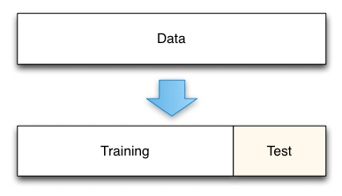
Train test split
Option 1 :
100% used as training and the same for testing
Option 2 :
X:Y ratio, X% of dataset is used as training and Y% of it as test

Slide 4
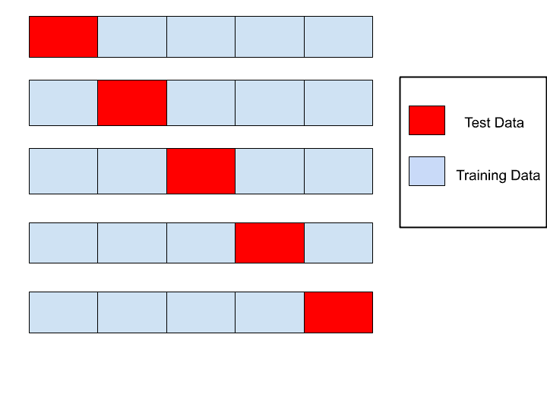
K-Fold cross validation

Slide 5
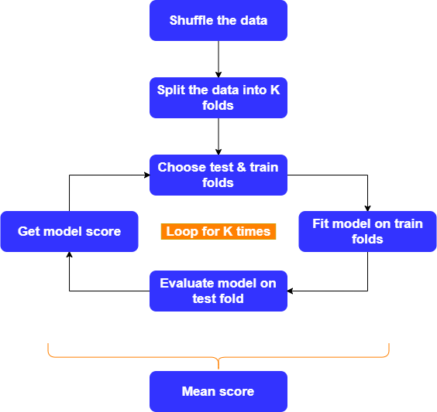
K-Fold cross validation (Working)

Slide 6
Overfitting
Underfitting
KNN
Parzen Window
SVM
RBF(Radial Basis Function)
Polynomial with high degree
Linear classifier
SVM
Linear kernel

Slide 7
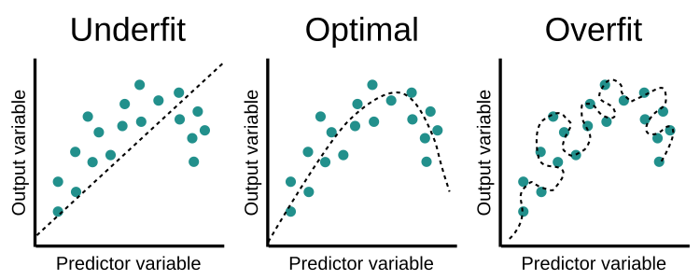

Slide 8
Reference
[1] Image - fitting https://www.olexsys.org/images/overfitting.png
[2] Image - K fold https://www.mltut.com/wp-content/uploads/2020/05/cross-validation.png
[3] Image - K fold - working https://raw.githubusercontent.com/satishgunjal/images/master/Inner_Working_KFold.png
[4] Image - Train test split - https://www.researchgate.net/figure/Train-Test-Data-Split_fig6_325870973

